Slide 1

State of Christianity
What is a Biblical World View
Survey Data
Questions

Slide 2

A Tale of
Two Surveys
What is the state of belief in the US today?
Ligonier & Barna Surveys
Criteria (What is a Biblical Worldview)
The Questions

Slide 3
US Religious Affiliations
Religious Composition by Country, 2010-2020 | Pew Research Center

Slide 4
World Religious Affiliations
Religious Composition by Country, 2010-2020 | Pew Research Center

Slide 5
What is a Biblical Worldview (Barna)?
Likely ~4% agree today (varies over time, ~10%-2017; 9% - 2021)…. (Based on Blue Text below)
Absolute moral truth exists
The Bible is totally accurate in all of the principles it teaches
Satan is considered to be a real being, not merely symbolic
God is all-knowing, all-powerful, and the Creator of the universe, ruling it today
A person cannot earn their way into Heaven doing good works
Salvation is a gift of God through Jesus Christ.
Jesus Christ lived a sinless life on earth
Jesus is fully God and fully man, and the only way of salvation
The Holy Spirit is real and active in the world today
People are born with a sinful nature
Christians have a responsibility to share their faith in Christ with others
The Bible provides a reliable moral framework for all areas of life
Heaven and hell are real, literal places
The chief purpose of life is to glorify God
Christianity is the one true faith, and Jesus is the only way to God
Notes:
US News | Only 6% Of Americans Believe Biblical Worldview, Barna Survey Reveals | Christianity Daily

Slide 6
What is a Biblical Worldview (Ligonier)?
Very small number agrees….
Scripture is God-breathed and eternal.
The Bible is God's truth, not myth.
Creation testifies to God's truth.
God exists eternally in three Persons.
God is unchanging and all-knowing.
Only Christ is the way to God.
Jesus is eternal Creator, not created.
Jesus is truly God and truly man.
Christ alone saves by His sacrifice.
The resurrection is a historical, bodily reality.
All people are sinners by nature.
All inherit sin from Adam.
Sin's wages are death apart from Christ.
God predestines according to His will.
Salvation is in Christ alone.
Justification is by faith alone.
Salvation is not by works.
The Spirit is fully God and personal.
Regeneration precedes and produces faith.
Scripture commands gathering as the church.
The church must preach truth, including justice and morality.
Hell is eternal conscious punishment.
Heaven is eternal fellowship with God.

Slide 7

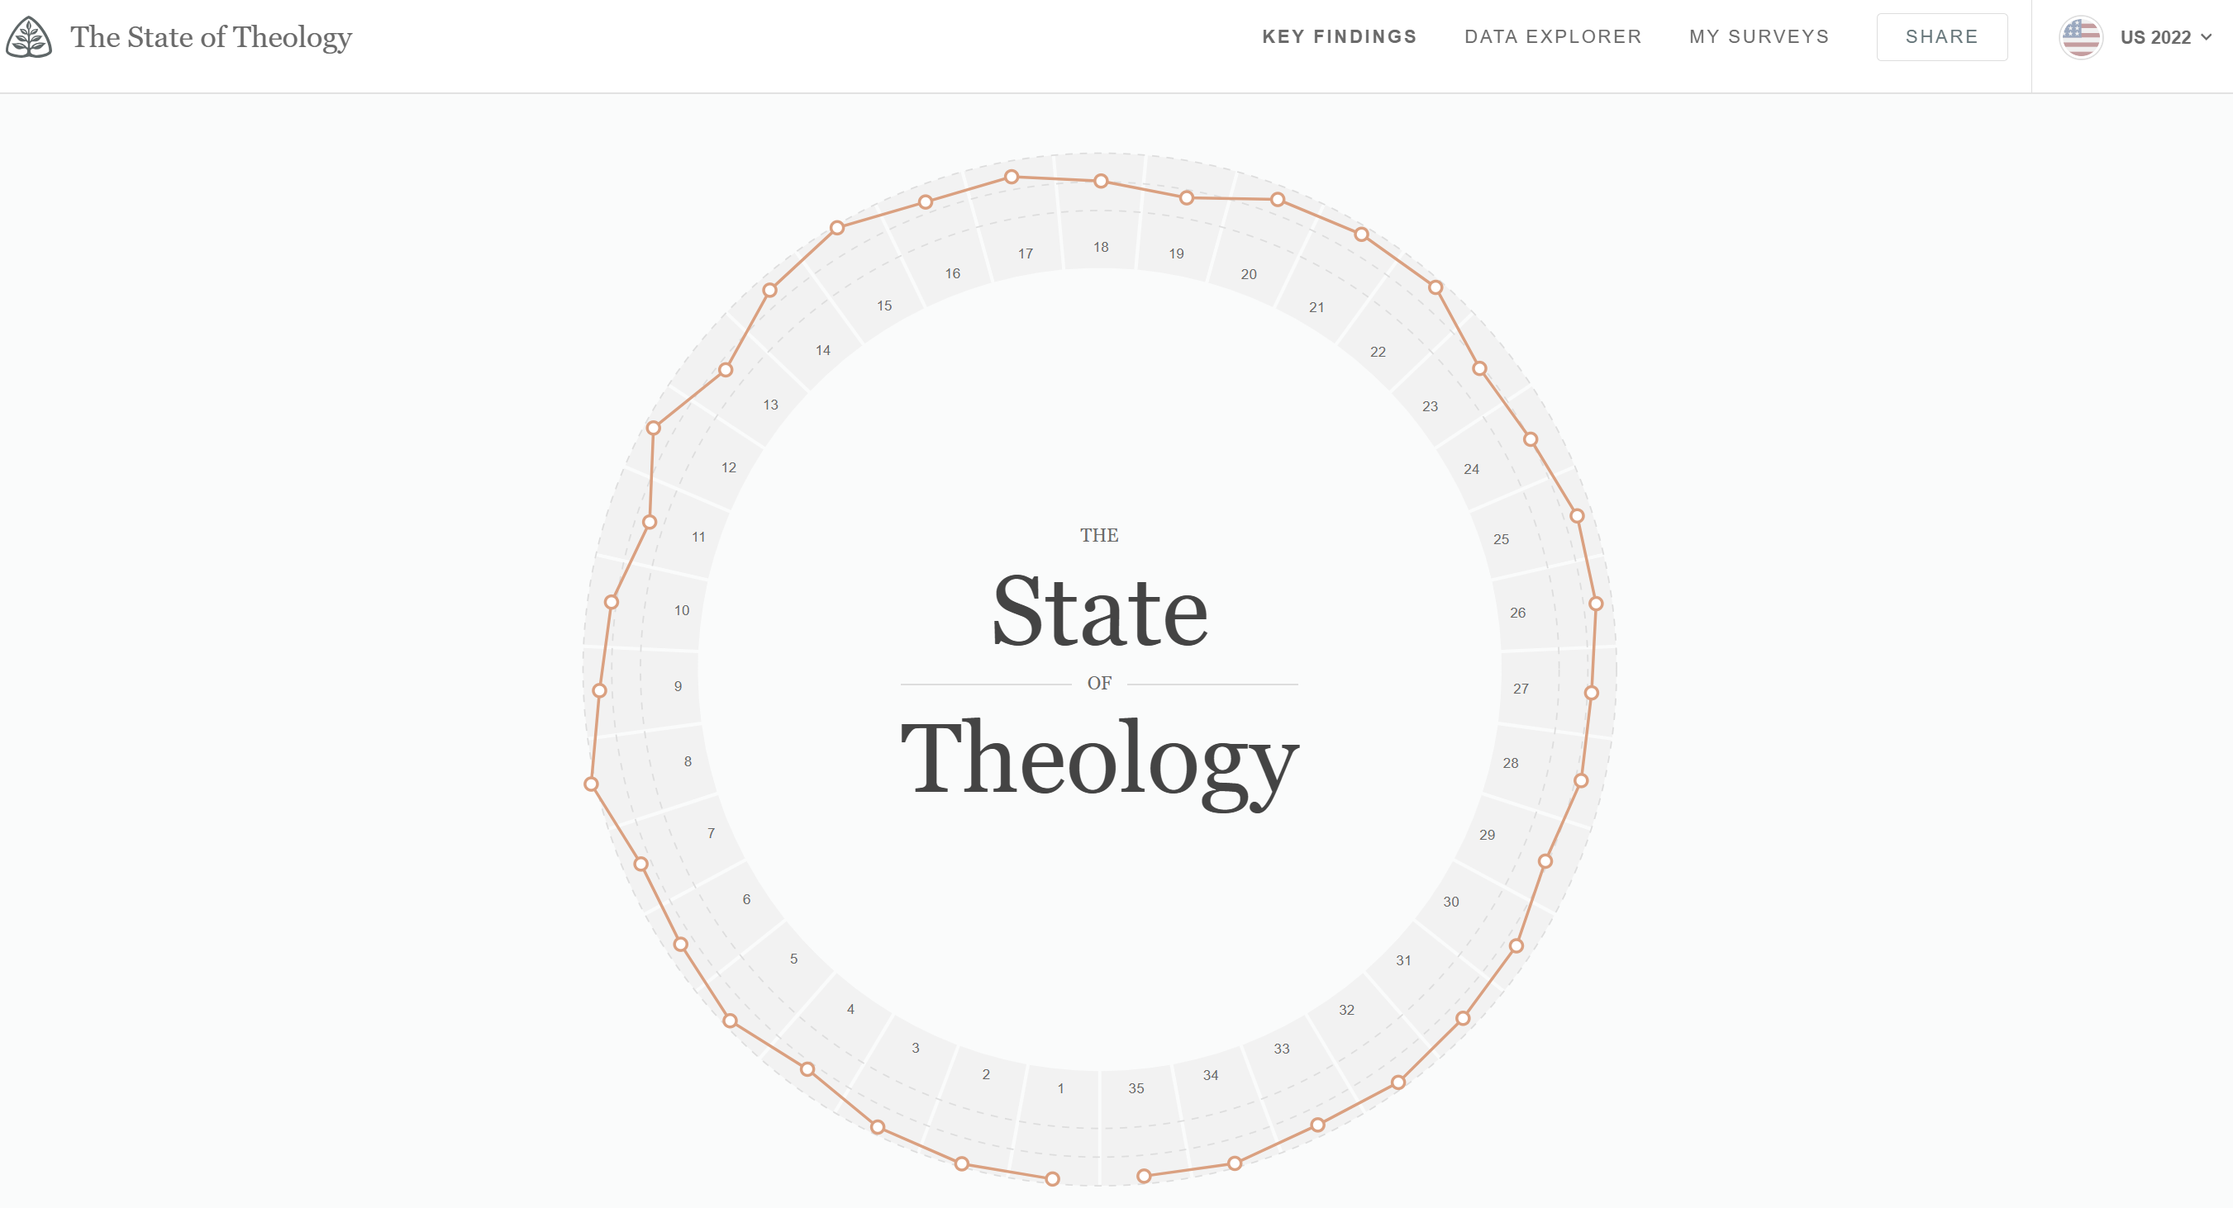
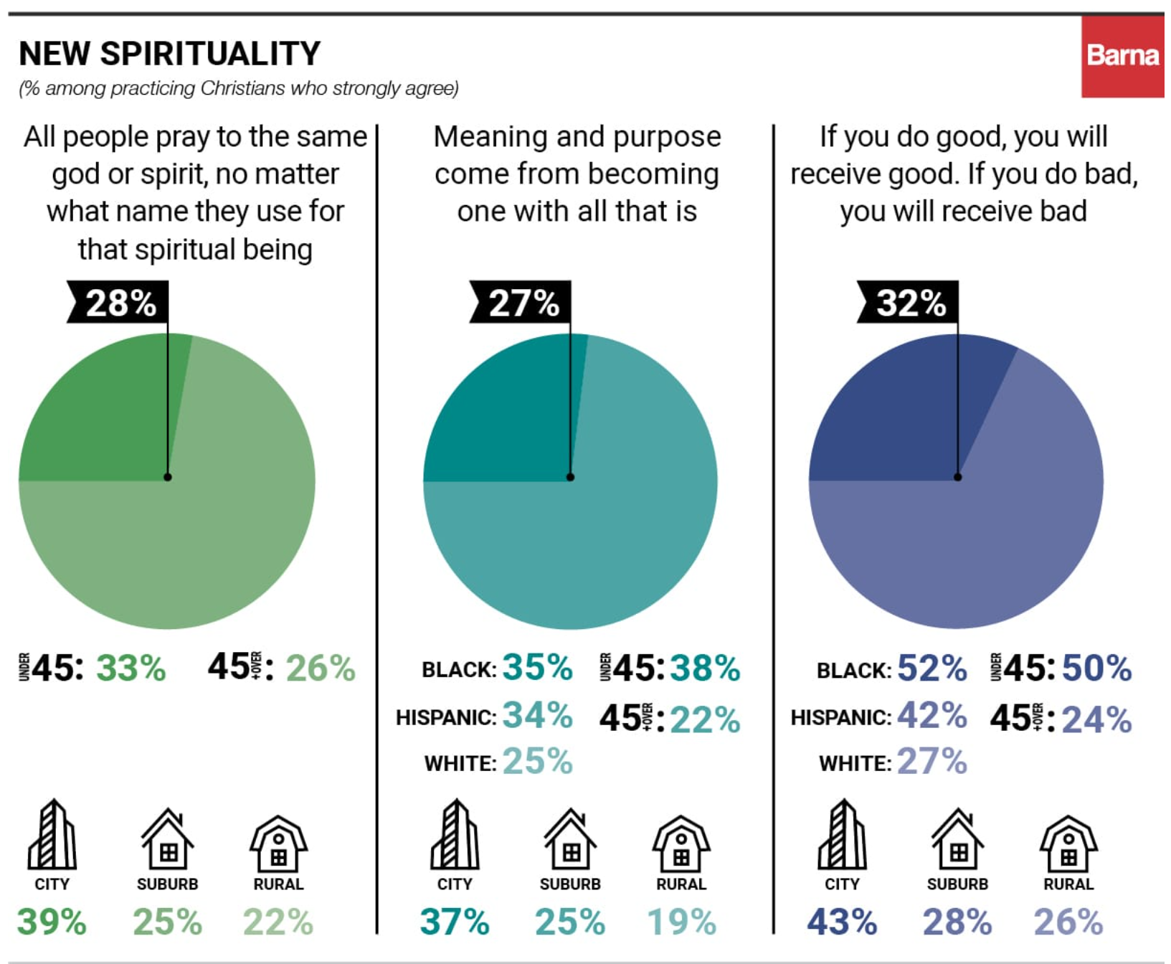
The Questions
The State of Theology
Competing Worldviews Influence Today’s Christians - Barna Group

Slide 8

So What?
Matthew 28:18 And Jesus came and spoke to them, saying, “All authority has been given to Me in heaven and on earth. 19 Go therefore and make disciples of all the nations, baptizing them in the name of the Father and of the Son and of the Holy Spirit, 20 teaching them to observe all things that I have commanded you; and lo, I am with you always, even to the end of the age.” Amen.
John 14:5 – If you love Me, keep My commandments.
Notes:
If ye love Me, keep My commandments. - John 14:15

