Slide 1
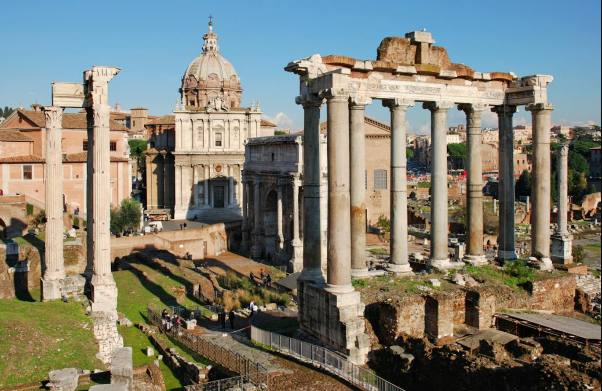
Romans 2 - The Religious Moralist
Romans 1
The Good News

Slide 2
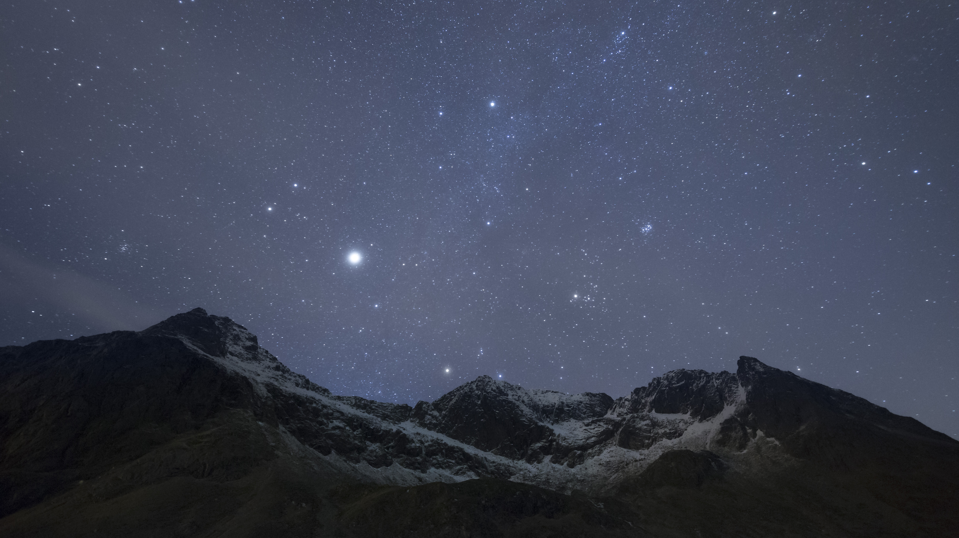
Opening Questions
Are all judged fairly?
What is the responsibility of the Jews?
Based on what are we judged?
Notes:
1:1-17 – Overview - Jesus is God, paid our price to satisfy a holy God, was prophesied in the OT, and we didn’t contribute to our salvation, without which we are all headed to hell. The good news.
1:18-3:1 – Demonstrating our deadness. Includes demonstrating that we do not die because of our sin, our sin demonstrates we are already dead.

Slide 3

Romans
Q & A
1 Therefore you are inexcusable, O man, whoever you are who judge, for in whatever you judge another you condemn yourself; for you who judge practice the same things. 2 But we know that the judgment of God is according to truth against those who practice such things. 3 And do you think this, O man, you who judge those practicing such things, and doing the same, that you will escape the judgment of God? 4 Or do you despise the riches of His goodness, forbearance, and longsuffering, not knowing that the goodness of God leads you to repentance? 5 But in accordance with your hardness and your impenitent heart you are treasuring up for yourself wrath in the day of wrath and revelation of the righteous judgment of God, 6 who “will render to each one according to his deeds”: 7 eternal life to those who by patient continuance in doing good seek for glory, honor, and immortality; 8 but to those who are self-seeking and do not obey the truth, but obey unrighteousness—indignation and wrath, 9 tribulation and anguish, on every soul of man who does evil, of the Jew first and also of the Greek; 10 but glory, honor, and peace to everyone who works what is good, to the Jew first and also to the Greek. 11 For there is no partiality with God.
Q: (v1) In the previous chapter Paul described how all understand the existence and expectations of God, including the “heathen” who had not been exposed to evangelism. What statement does Paul make here concerning those who judge them?
They are just as bad since they:
1. Minimize God’s standard against themselves using false measures
2. Don’t understand the depths of their own sins
Q: (v2) Is God’s judgement partial or inconsistent?
No, He judges all perfectly
Q: (v3) What principle does verse 3 indicate?
If a person has enough knowledge to judge another person, they are on the hook for judging themselves, including the motivations of the heart.
Q: (v4) What is one purpose for God’s goodness, forbearance, and longsuffering?
To lead men/women to repentance.
The moralist judge doesn’t understand these traits of God are for them just as much as for the person they are judging.

Slide 4
Romans
Q & A
1 Therefore you are inexcusable, O man, whoever you are who judge, for in whatever you judge another you condemn yourself; for you who judge practice the same things. 2 But we know that the judgment of God is according to truth against those who practice such things. 3 And do you think this, O man, you who judge those practicing such things, and doing the same, that you will escape the judgment of God? 4 Or do you despise the riches of His goodness, forbearance, and longsuffering, not knowing that the goodness of God leads you to repentance? 5 But in accordance with your hardness and your impenitent heart you are treasuring up for yourself wrath in the day of wrath and revelation of the righteous judgment of God, 6 who “will render to each one according to his deeds”: 7 eternal life to those who by patient continuance in doing good seek for glory, honor, and immortality; 8 but to those who are self-seeking and do not obey the truth, but obey unrighteousness—indignation and wrath, 9 tribulation and anguish, on every soul of man who does evil, of the Jew first and also of the Greek; 10 but glory, honor, and peace to everyone who works what is good, to the Jew first and also to the Greek. 11 For there is no partiality with God.
Q: (v5) Hardness of Heart:
The word is “sclerosis,” the hardening of arteries, in this sense not physical but spiritual. The hardening happens over time, not necessarily immediately.
Q: (v5) Why is the moralist storing up wrath?
He doesn’t recognize the truth and repenting (turning 180 degrees from the wrong path).
Q: (v5) When is the judgement of god (day of wrath)?
This is the great white throne judgement, at the end of the millennium.
Q: (v6) Are all un-saved punished in the same way?
Though salvation is not attained on the basis of works, degrees of rewards and punishment are based on deeds. Some sources - Is. 3:10, 11; Jer. 17:10; John 5:28, 29; 1 Cor. 3:8; 2 Cor. 5:10; Gal. 6:7–9; cf. Rom. 14:12
Q: (v7) What are we encouraged to do?
Seek good resulting in glory, honor and immortality
Q: (v8) Who receives indignation, wrath, tribulation and aguish?
Those who are self-seeking and not obeying the truth
Q: (v9-11) Who does God favor?
None! There is no partiality with God

Slide 5
Romans
Q & A
12 For as many as have sinned without law will also perish without law, and as many as have sinned in the law will be judged by the law 13 (for not the hearers of the law are just in the sight of God, but the doers of the law will be justified; 14 for when Gentiles, who do not have the law, by nature do the things in the law, these, although not having the law, are a law to themselves, 15 who show the work of the law written in their hearts, their conscience also bearing witness, and between themselves their thoughts accusing or else excusing them) 16 in the day when God will judge the secrets of men by Jesus Christ, according to my gospel.
Q: (v12, 14) To what extent are humans responsible for obeyance?
We are all held accountable with what we know.
Q: (v15) Why are we responsible?
The law is on our hearts, in our conscience
Q: (v16) Atheists and Pagans often talk of their good deeds. What are some things written on every person’s heart?
Moral laws
Honesty
Integrity
Compassion
Goodness towards others
Q: What happens after to us after ignoring our consciences for a long period of time?
It becomes dull, at some point we are turned over to a debased mind
Q: (v) When will judgement of all occur?
Great white throne judgment

Slide 6
Romans
Q & A
17 Indeed you are called a Jew, and rest on the law, and make your boast in God, 18 and know His will, and approve the things that are excellent, being instructed out of the law, 19 and are confident that you yourself are a guide to the blind, a light to those who are in darkness, 20 an instructor of the foolish, a teacher of babes, having the form of knowledge and truth in the law. 21 You, therefore, who teach another, do you not teach yourself? You who preach that a man should not steal, do you steal? 22 You who say, “Do not commit adultery,” do you commit adultery? You who abhor idols, do you rob temples? 23 You who make your boast in the law, do you dishonor God through breaking the law? 24 For “the name of God is blasphemed among the Gentiles because of you,” as it is written. 25 For circumcision is indeed profitable if you keep the law; but if you are a breaker of the law, your circumcision has become uncircumcision. 26 Therefore, if an uncircumcised man keeps the righteous requirements of the law, will not his uncircumcision be counted as circumcision? 27 And will not the physically uncircumcised, if he fulfills the law, judge you who, even with your written code and circumcision, are a transgressor of the law? 28 For he is not a Jew who is one outwardly, nor is circumcision that which is outward in the flesh; 29 but he is a Jew who is one inwardly; and circumcision is that of the heart, in the Spirit, not in the letter; whose praise is not from men but from God.
Q: (v18) Apart from the revelation and conscience, how do Jews (from the word Judah) know God’s will?
The written and oral laws were brought to them first
Q: (v) According to the Holy Spirit via Paul, the Jews appear to have thought they had a higher place with God. Did this excuse their behavior?
No, just the opposite.
Q: (v23-24) What is the consequence of taking advantage of their position?
Dishonor to God
Setting a bad example to the gentiles
Q: (v29) What is circumcision of the heart?
The inner reality of salvation, not outer.
An outward appearance of salvation didn’t save the Jew, just the opposite.
How we look to men is not important, God sees the heart.

Slide 7
Romans
Q & A
1
Q: (v) a
a
Q: (v) a?
a
Q: (v) a?
A
Q: (v) a?
a

Slide 8

2 Tim 3
A Last Day Sign
1 But know this, that in the last days perilous times will come: 2 For men will be lovers of themselves, lovers of money, boasters, proud, blasphemers, disobedient to parents, unthankful, unholy, 3 unloving, unforgiving, slanderers, without self-control, brutal, despisers of good, 4 traitors, headstrong, haughty, lovers of pleasure rather than lovers of God, 5 having a form of godliness but denying its power. And from such people turn away! 6 For of this sort are those who creep into households and make captives of gullible women loaded down with sins, led away by various lusts, 7 always learning and never able to come to the knowledge of the truth. 8 Now as Jannes and Jambres resisted Moses, so do these also resist the truth: men of corrupt minds, disapproved concerning the faith; 9 but they will progress no further, for their folly will be manifest to all, as theirs also was.

Slide 9
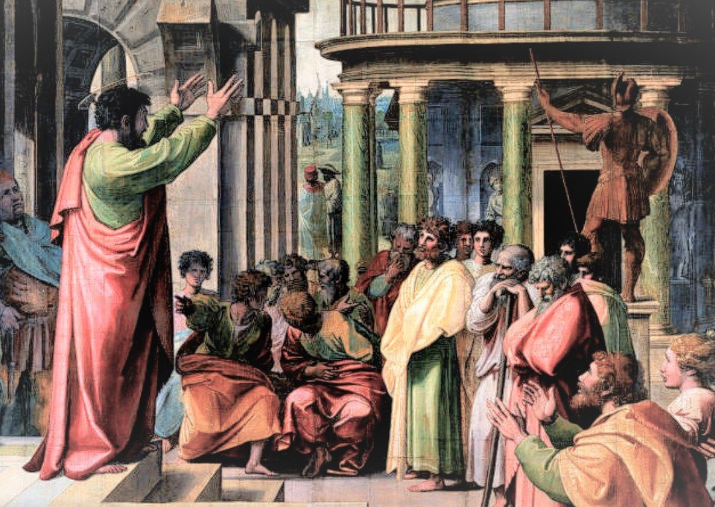
Theme
For I am not ashamed of the gospel of Christ, for it is the power of God to salvation for everyone who believes, for the Jew first and also for the Greek. For in it the righteousness of God is revealed from faith to faith; as it is written, “The just shall live by faith.” – Rom 1:16-17
Notes:
1 Thessalonians (circa ad 51)
1 Corinthians (circa ad 52–55)
2 Corinthians (circa ad 52–55)
Galatians (circa ad 50–55)
Romans (circa ad 55–57)
Philemon (circa ad 55–56)
Philippians (circa ad 55–56)
Anthony Le Donne, Paul the Apostle, ed. John D. Barry et al., The Lexham Bible Dictionary (Bellingham, WA: Lexham Press, 2016).
Anthony Le Donne, “Paul the Apostle,” ed. John D. Barry et al., The Lexham Bible Dictionary (Bellingham, WA: Lexham Press, 2016).

Slide 10
The Christian’s Riches
1 Corinthians/ 2: Isa 64/65 - Eye has not seen, nor ear heard, Nor have entered the heart of man, The things which God has prepared for those who love Him
John 3:16 – Life that will never end
John 4:14 – A spring of spiritual water that will never dry up
John 6: 37, 39 – A gift that will never be lost
Romans 8: 39 – a love from which he can never be separated
Romans 11: 29 – a calling that will never be revoked
2 Timothy 2: 19 – a foundation that will never be destroyed
1 Peter 1: 4– 5 – An inheritance that will never diminish

Slide 11
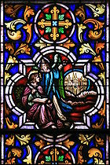
Next Up
Romans

Slide 12
Psalm 19:1-6
We Hear the Natural World Speaking
The heavens declare the glory of God;
the skies proclaim the work of his hands.
Day after day they pour forth speech;
night after night they display knowledge.
There is no speech or language
where their voice is not heard.
Their voice goes out into all the earth,
their words to the ends of the world.
In the heavens he has pitched a tent for the sun,
which is like a bridegroom coming forth from his pavilion,
like a champion rejoicing to run his course.
It rises at one end of the heavens
and makes its circuit to the other;
nothing is hidden from its heat.

Slide 13
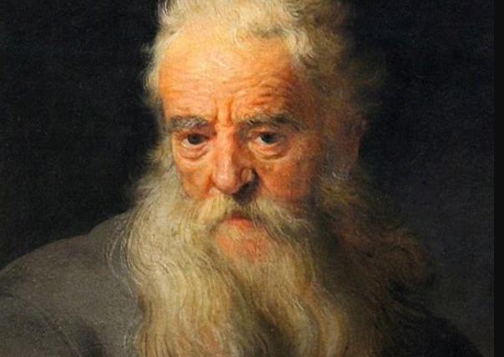
Co-writer – Apostle Paul
Born as Saul in Tarsus (on the southern coast of modern-day Turkey). Likely borne about the same time as Jesus.
Schooled as a Pharisee under the Jerusalem religious famous Gamaliel.
Became a traveling missionary and preacher for the early church; renamed Paul.
Worked as an artisan who made tents – maybe subcomponents
Was imprisoned multiple times by the Roman authorities for his religious agitation.
Believed to have co-written 6 letters to the churches.
Died sometime between AD 62–64; Paul, believed to be in Rome.
Notes:
Paul was probably bald and scared badly…

Slide 14
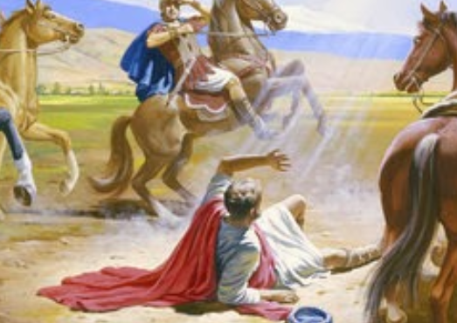
AD 33 Damascus – Direct conversion
AD 33-36 Arabia – Receiving direct revelation from the Lord (Gal 1)
3 missionary journeys to Asia minor
AD 56 Wrote Romans on 3rd journey in Corinth

Slide 15
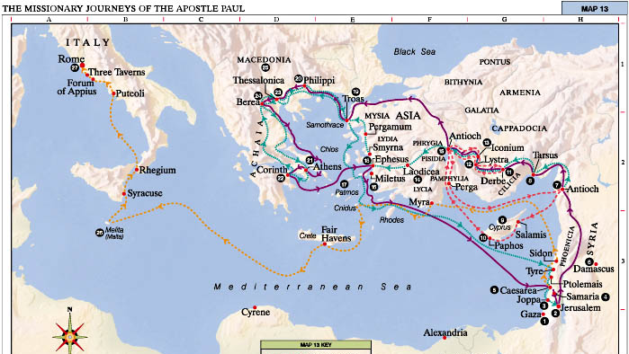

Slide 16
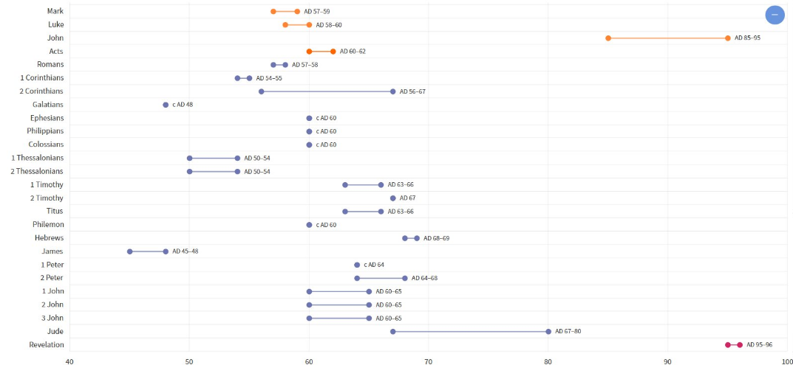

Slide 17
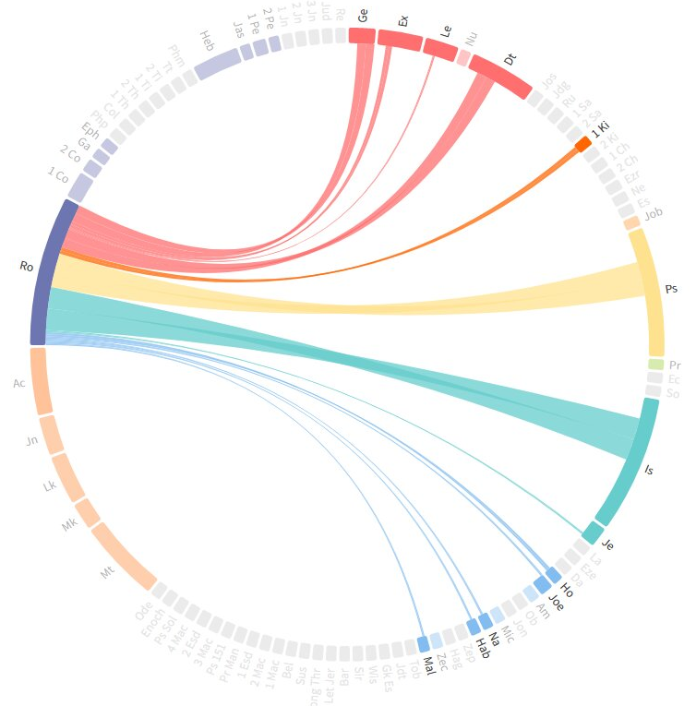
  Romans ties to other books of the bible

Slide 18

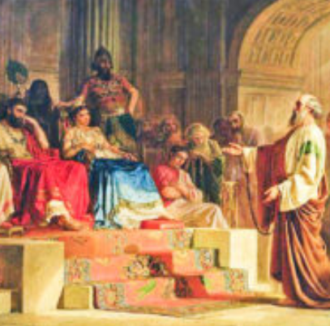
Paul’s Testimony to Agrippa – Acts 26
1. Then Agrippa said to Paul, “You are permitted to speak for yourself.”
So Paul stretched out his hand and answered for himself: 2 “I think myself happy, King Agrippa, because today I shall answer for myself before you concerning all the things of which I am accused by the Jews, 3 especially because you are expert in all customs and questions which have to do with the Jews. Therefore I beg you to hear me patiently.
4 “My manner of life from my youth, which was spent from the beginning among my own nation at Jerusalem, all the Jews know. 5 They knew me from the first, if they were willing to testify, that according to the strictest sect of our religion I lived a Pharisee. 6 And now I stand and am judged for the hope of the promise made by God to our fathers. 7 To this promise our twelve tribes, earnestly serving God night and day, hope to attain. For this hope’s sake, King Agrippa, I am accused by the Jews. 8 Why should it be thought incredible by you that God raises the dead?
9 “Indeed, I myself thought I must do many things contrary to the name of Jesus of Nazareth. 10 This I also did in Jerusalem, and many of the saints I shut up in prison, having received authority from the chief priests; and when they were put to death, I cast my vote against them. 11 And I punished them often in every synagogue and compelled them to blaspheme; and being exceedingly enraged against them, I persecuted them even to foreign cities.
Notes:
Reason to be…

Slide 19
Paul’s Testimony to Agrippa – Acts 26
12 “While thus occupied, as I journeyed to Damascus with authority and commission from the chief priests, 13 at midday, O king, along the road I saw a light from heaven, brighter than the sun, shining around me and those who journeyed with me. 14 And when we all had fallen to the ground, I heard a voice speaking to me and saying in the Hebrew language, ‘Saul, Saul, why are you persecuting Me? It is hard for you to kick against the goads.’ 15 So I said, ‘Who are You, Lord?’ And He said, ‘I am Jesus, whom you are persecuting. 16 But rise and stand on your feet; for I have appeared to you for this purpose, to make you a minister and a witness both of the things which you have seen and of the things which I will yet reveal to you. 17 I will deliver you from the Jewish people, as well as from the Gentiles, to whom I now send you, 18 to open their eyes, in order to turn them from darkness to light, and from the power of Satan to God, that they may receive forgiveness of sins and an inheritance among those who are sanctified by faith in Me.’
19 “Therefore, King Agrippa, I was not disobedient to the heavenly vision, 20 but declared first to those in Damascus and in Jerusalem, and throughout all the region of Judea, and then to the Gentiles, that they should repent, turn to God, and do works befitting repentance. 21 For these reasons the Jews seized me in the temple and tried to kill me. 22 Therefore, having obtained help from God, to this day I stand, witnessing both to small and great, saying no other things than those which the prophets and Moses said would come—23 that the Christ would suffer, that He would be the first to rise from the dead, and would proclaim light to the Jewish people and to the Gentiles.”
Notes:
Agrippa -

Slide 20
Paul’s Testimony to Agrippa – Acts 26
24 Now as he thus made his defense, Festus said with a loud voice, “Paul, you are beside yourself! Much learning is driving you mad!”
25 But he said, “I am not mad, most noble Festus, but speak the words of truth and reason. 26 For the king, before whom I also speak freely, knows these things; for I am convinced that none of these things escapes his attention, since this thing was not done in a corner. 27 King Agrippa, do you believe the prophets? I know that you do believe.”
28 Then Agrippa said to Paul, “You almost persuade me to become a Christian.”
29 And Paul said, “I would to God that not only you, but also all who hear me today, might become both almost and altogether such as I am, except for these chains.”
30 When he had said these things, the king stood up, as well as the governor and Bernice and those who sat with them; 31 and when they had gone aside, they talked among themselves, saying, “This man is doing nothing deserving of death or chains.”
32 Then Agrippa said to Festus, “This man might have been set free if he had not appealed to Caesar.”
Notes:
Agrippa – You are too smart…

Slide 21
The Depravity of Man – The Bad News
Self-will and self satisfaction reign in mans heart
This produces guilt, masked with even more self-seeking
This produces meaninglessness, as nothing truly satisfies
This produces hopelessness, we sense the supernatural promise of life after death and the consequences of it
Notes:
Paul can’t contain himself. He instantly jumps into the message of Romans
There is bad news, we can’t save ourselves. Spoken by the most learned and accomplished Jewish leader ever.
There is a path to salvation, it is accomplished by God
This is the Good news

Slide 22
Romans
Q & A
1
Q: (v) a
a
Q: (v) a?
a
Q: (v) a?
A
Q: (v) a?
a

